Slide 1
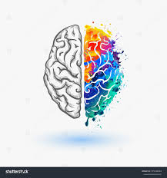
PERSONALITY TEST
Every person is colorful.
We just have to see their colors.

Slide 2
<info about test>
Anushka
Neelam
Take Test
Attitude Latitude Graph
Pg:1

Slide 3
PERSONALITY TEST
PART -1 introvert or Extrovert
Instructions
Q. Do you like crowds?
YES
NO
NEXT
Pg:2

Slide 4
PERSONALITY TEST
PART -1 Optimist or Pessimist
Instructions
I am an optimist
Inaccurate
Accurate
SUBMIT
Pg:3

Slide 5
PERSONALITY TEST
Your Personality Type Results
You are a __________ & __________ person
About your type
Info about I/E
Info about O/P
Pg:4

Slide 6
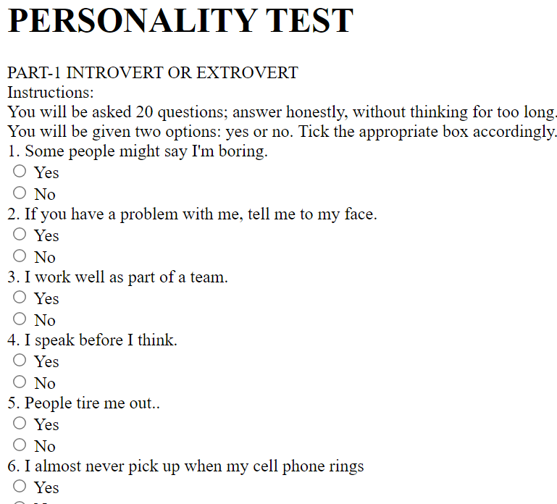
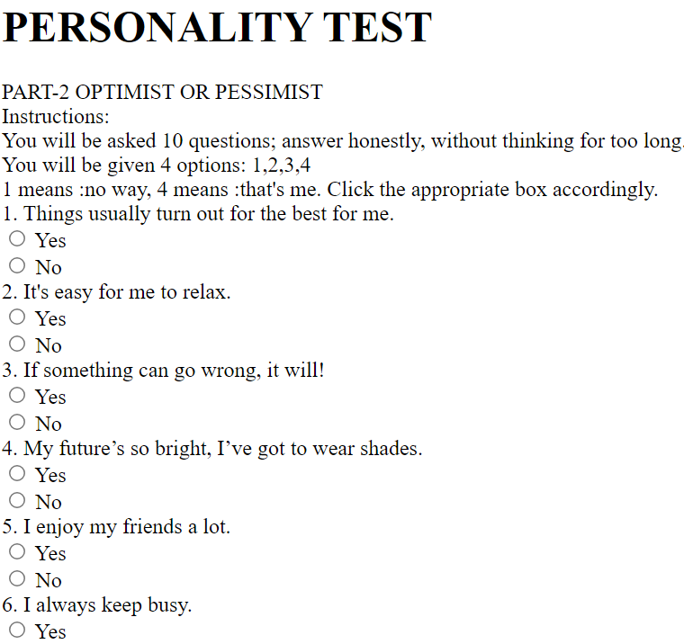
A snippet of my code

